Slide 1
Extract the data through ECC system
Milind Parab

Slide 2
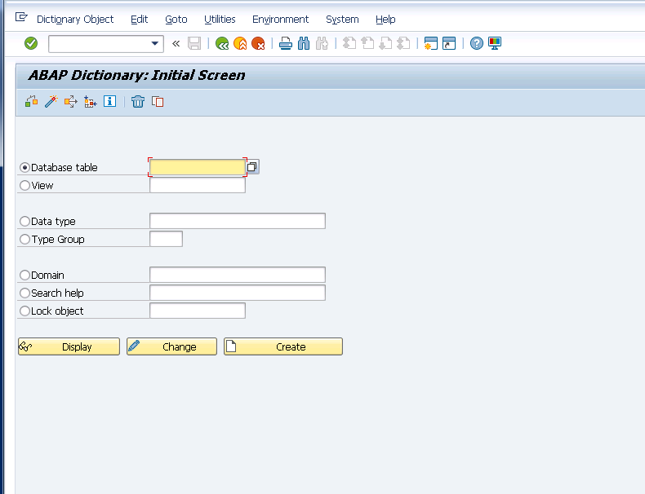
Logic to SAP and enter T-code “SE11”

Slide 3
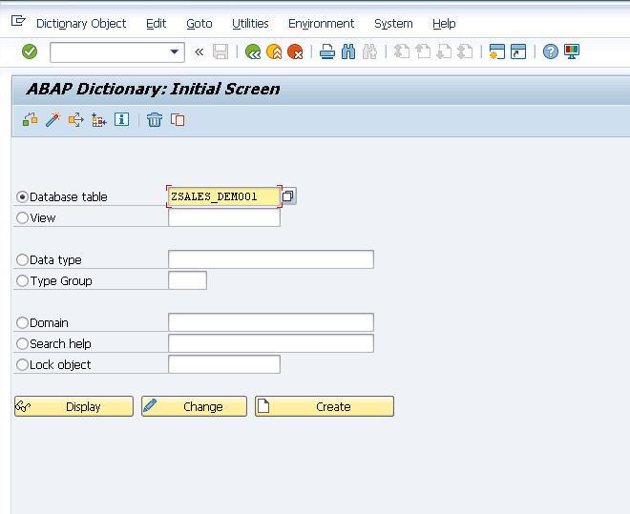
Create database “ZSALES_DEMO1”

Slide 4
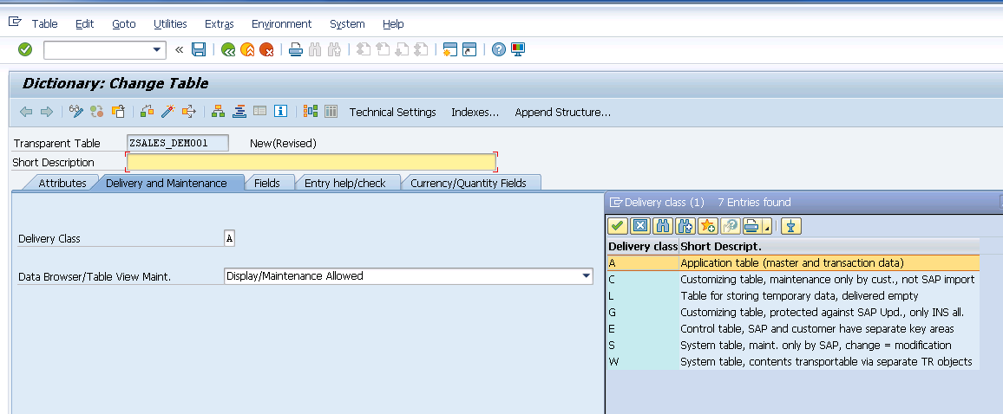
Table type A and Table View Maint.

Slide 5
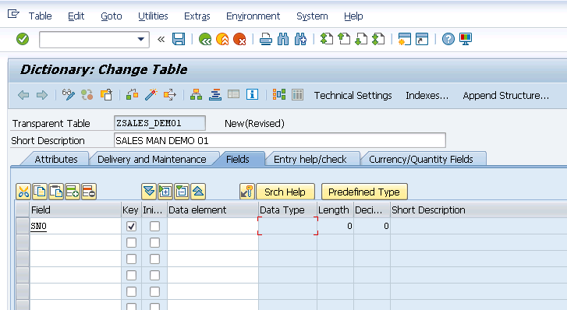
Switch to predefined to data element type.

Slide 6
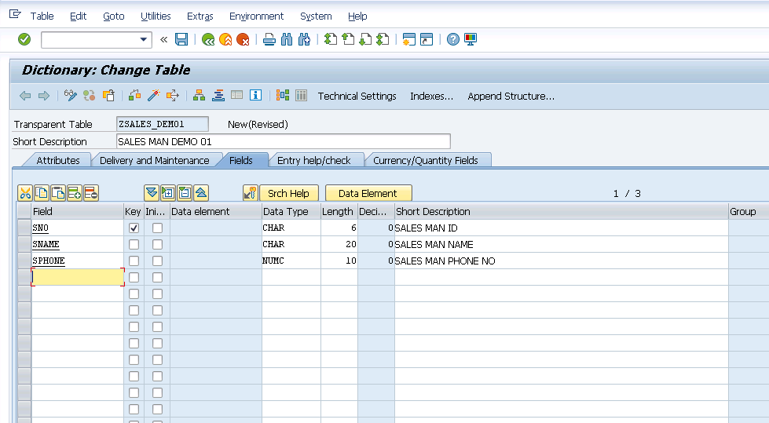
Cont.

Slide 7
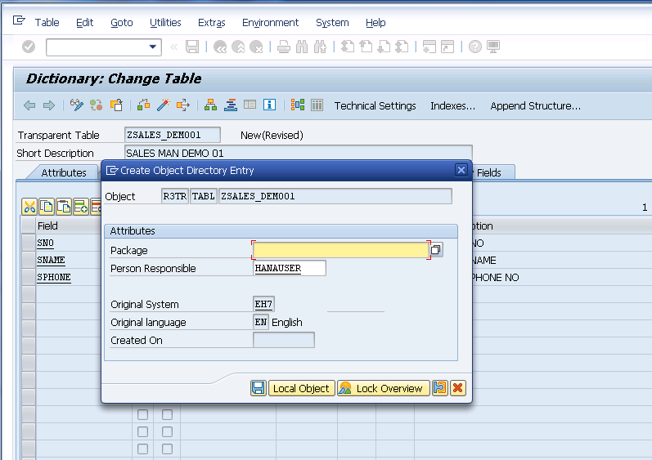
Activate and click on local object.

Slide 8
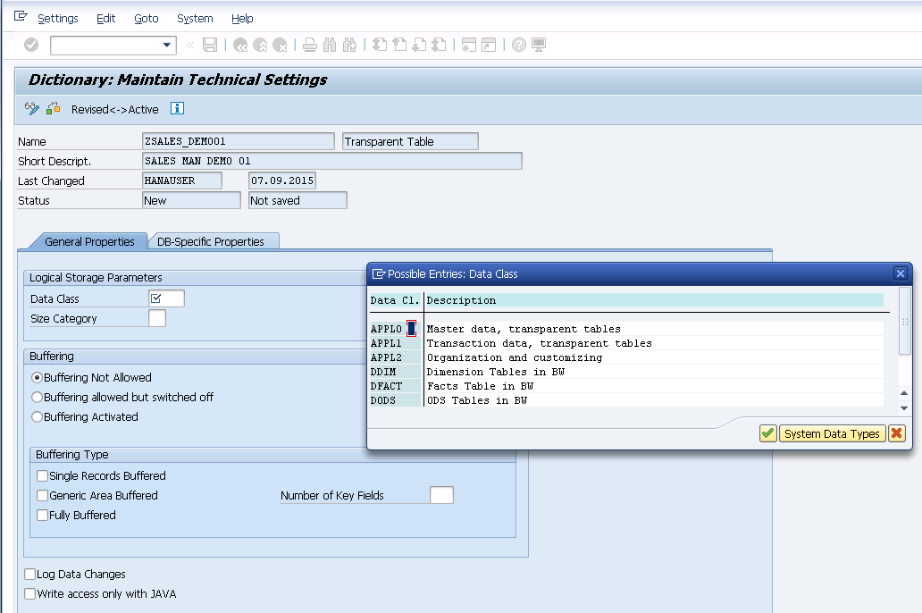
Select APPL0.

Slide 9
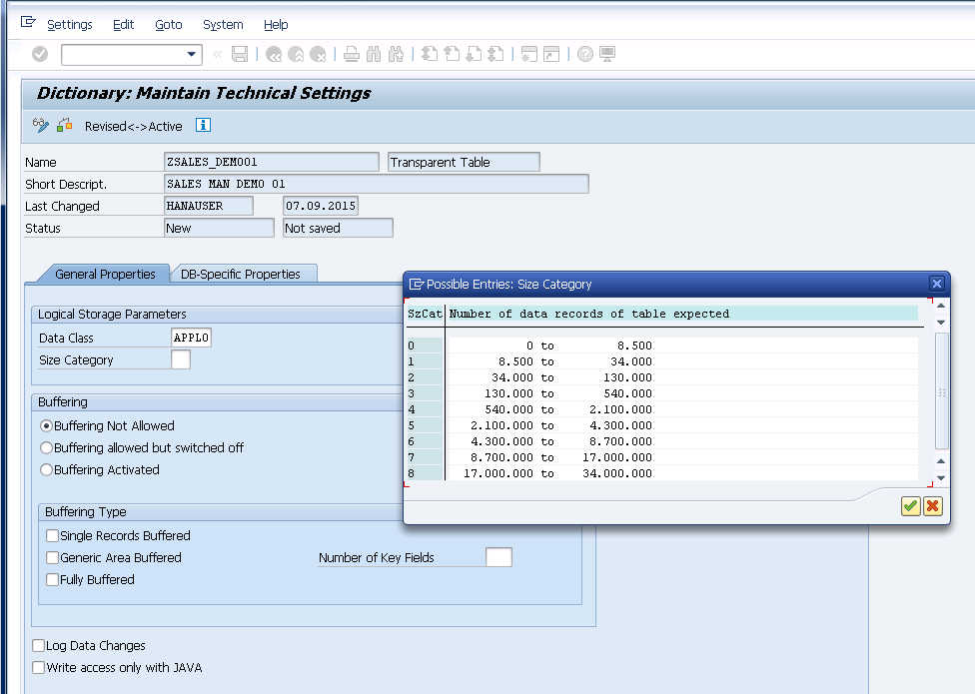
Select 0.

Slide 10
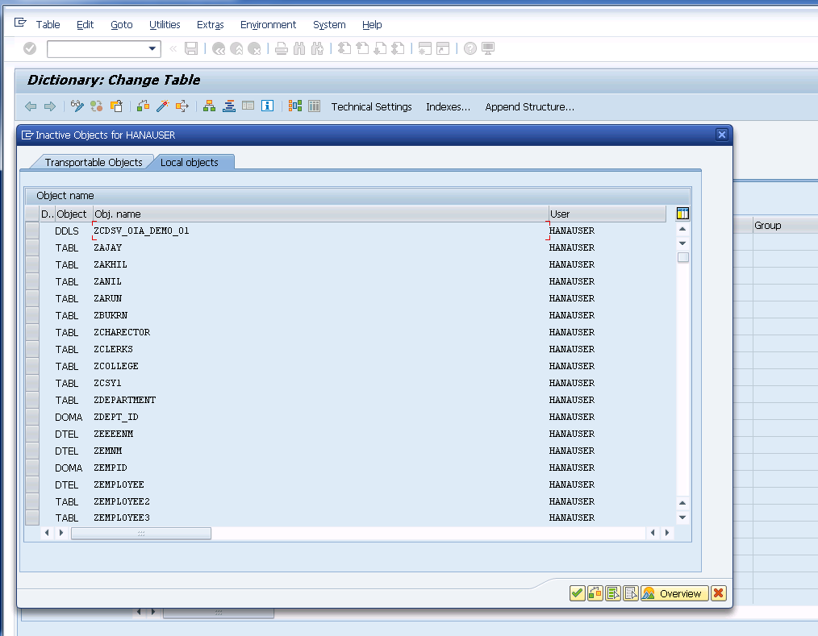
Save, go back and continue.

Slide 11
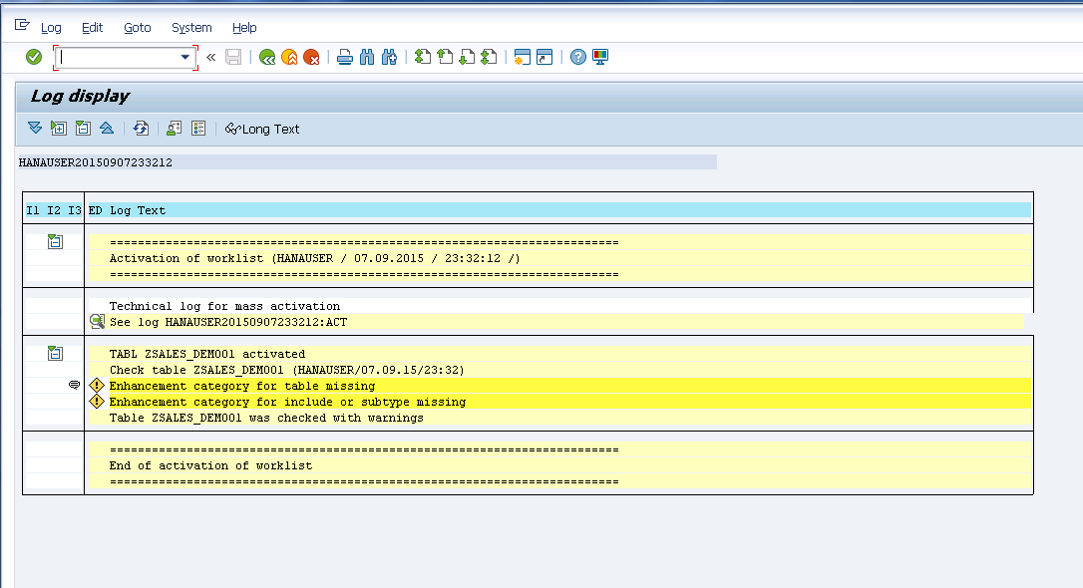
Go back and activate.

Slide 12
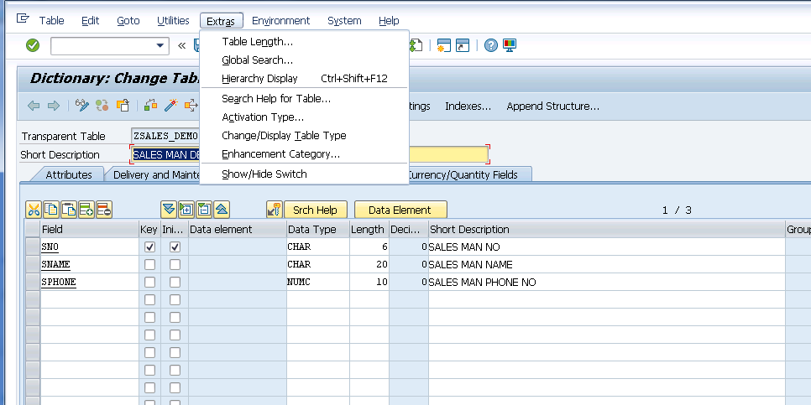
Go to enhancement category.

Slide 13
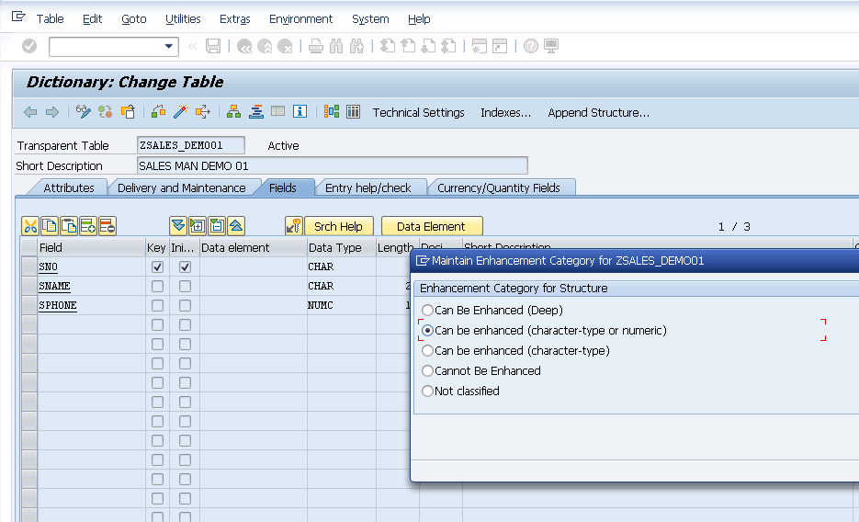
Cont.

Slide 14
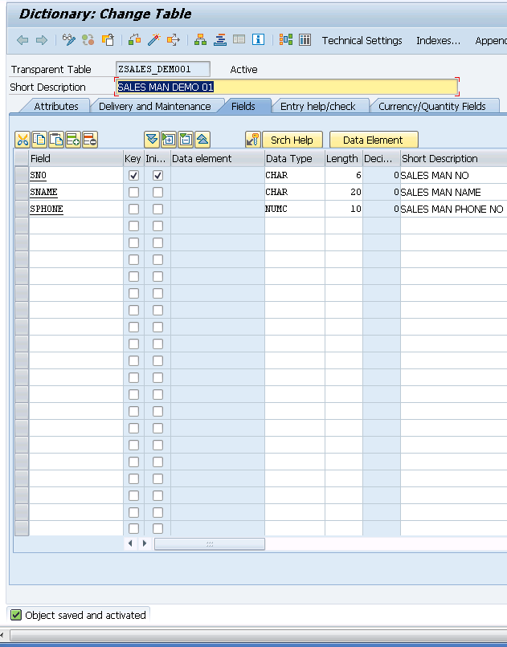
Activate the table.

Slide 15
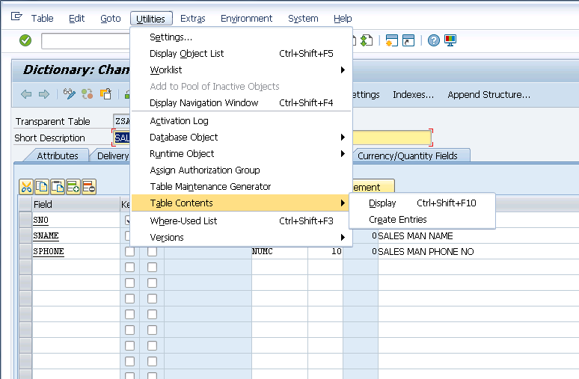
Now click on table entries.

Slide 16
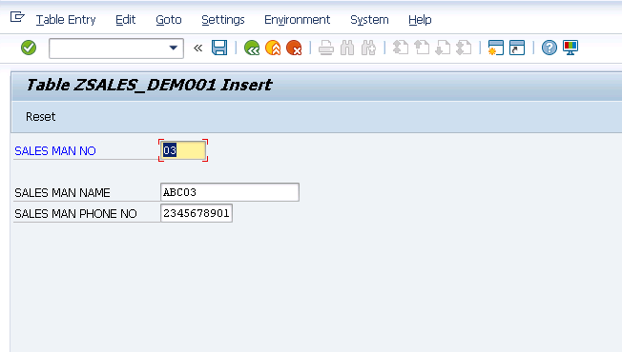
Create some table entries, save and reset.

Slide 17
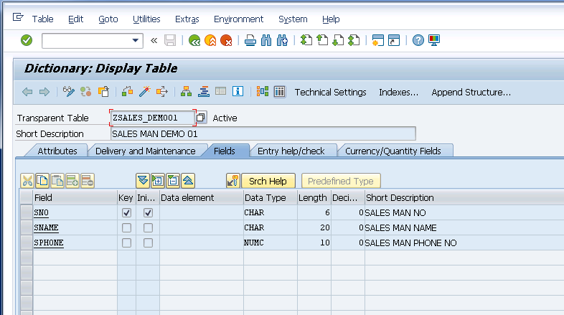
Click on content tab to see the entries.

Slide 18
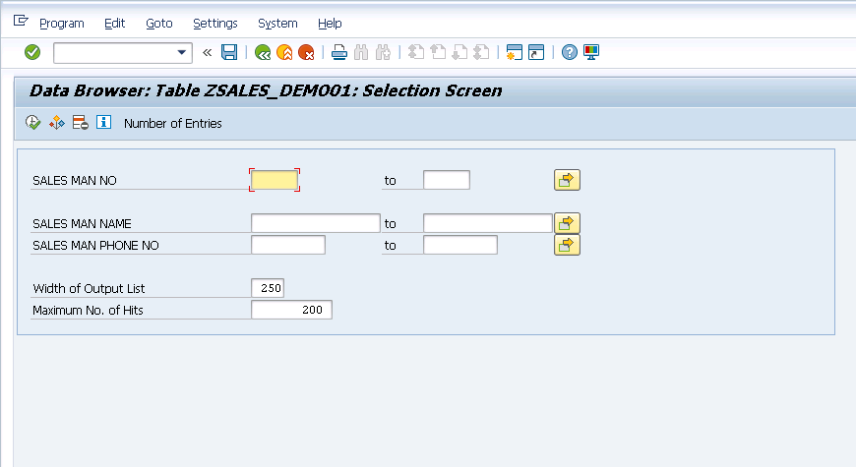
Execute to see all entries.

Slide 19
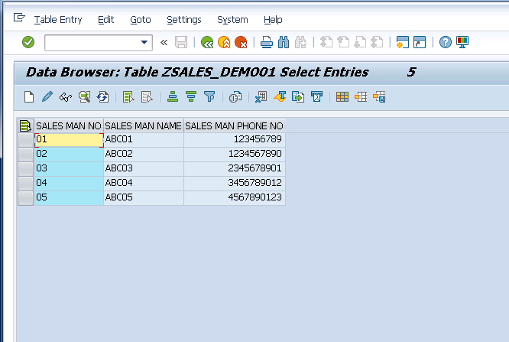
Cont.

Slide 20
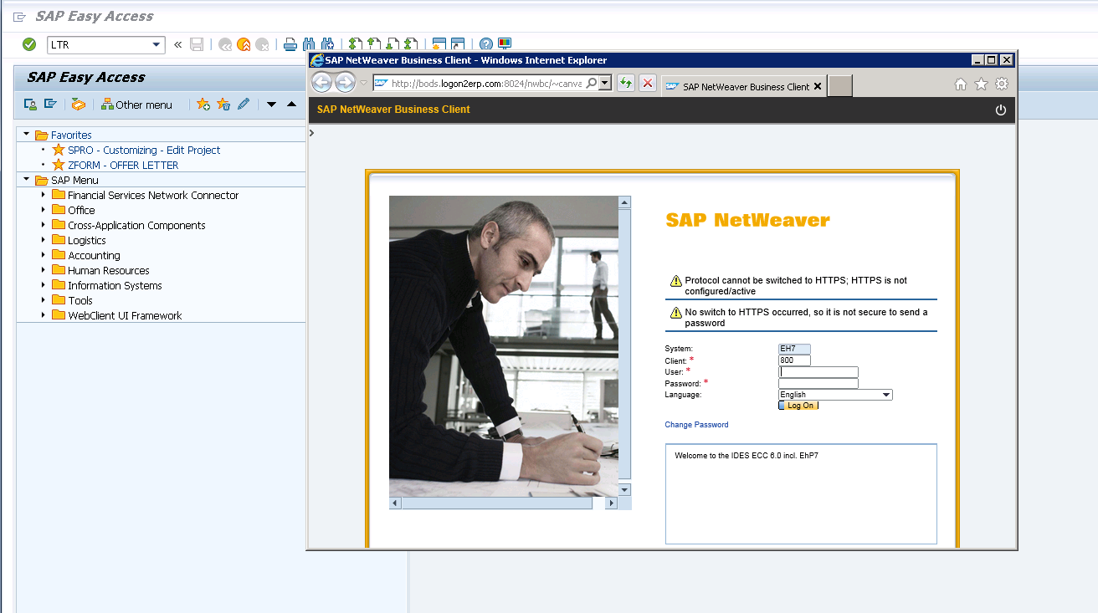
Click LTR, it will open up SAP NnetWeaver.

Slide 21
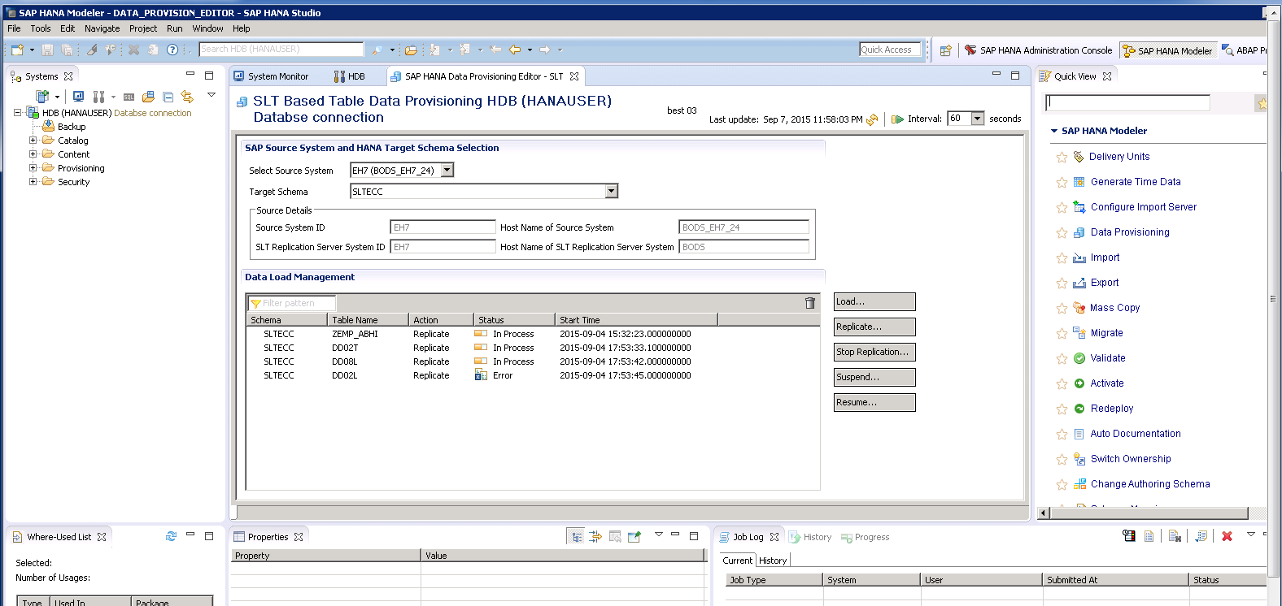
Connect to Hana DB.

